Slide 1





KawaiiRecSys: Anime Recommendation System

Slide 2

KawaiiRecSys – Smart Anime Recommendation System
Uses three algorithms: SVD, Neural Network, and Content-Based
Gives personal and accurate anime suggestions
Lets users adjust the mix of the three methods
Easy to use, powerful, and made for anime fans
Notes:
“Hi everyone! Today I’m going to talk about KawaiiRecSys, a smart anime recommendation system.
This system doesn’t rely on just one method. It uses three different algorithms to find the best anime for each person:
One that looks at user ratings (SVD),
One that uses AI and neural networks, and
One that checks anime genres and descriptions.
Because it mixes all three, it gives better and more personalized suggestions. Also, users can change how much each method is used, which makes the system flexible and fun to use.”

Slide 3
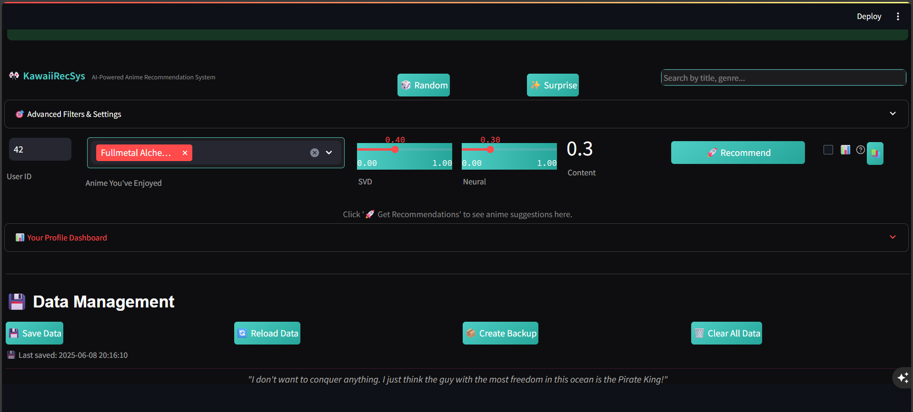

Slide 4
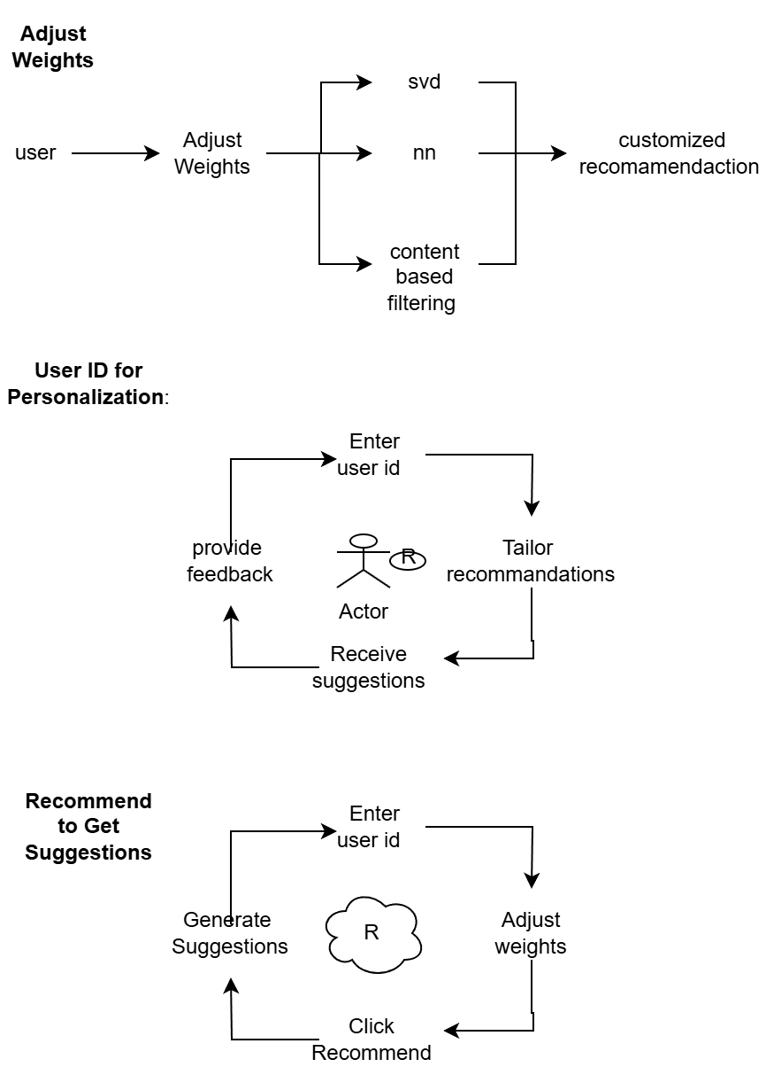


Slide 5
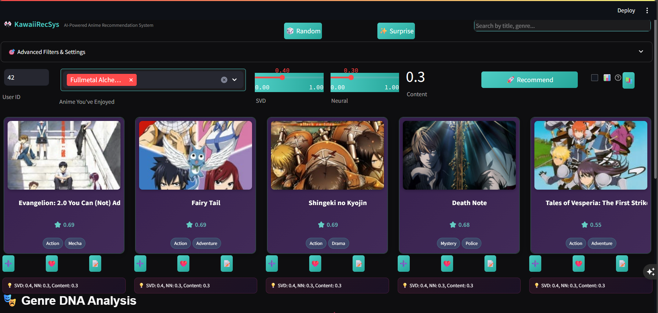

Slide 6

Anime Recommendation Card Structure
User Interaction Cycle in Anime Recommendations
Genre Tags
Categorization for user interest
Like Anime
Predicted Score
User enjoyment level anticipation
Add to Watchlist
Pass Anime
Anime Title
The central identity of the anime

Slide 7

Contribution of Algorithms to Anime Recommendations
SVD
40%
Neural Networks
30%
Content-Based Filtering
30%

Slide 8
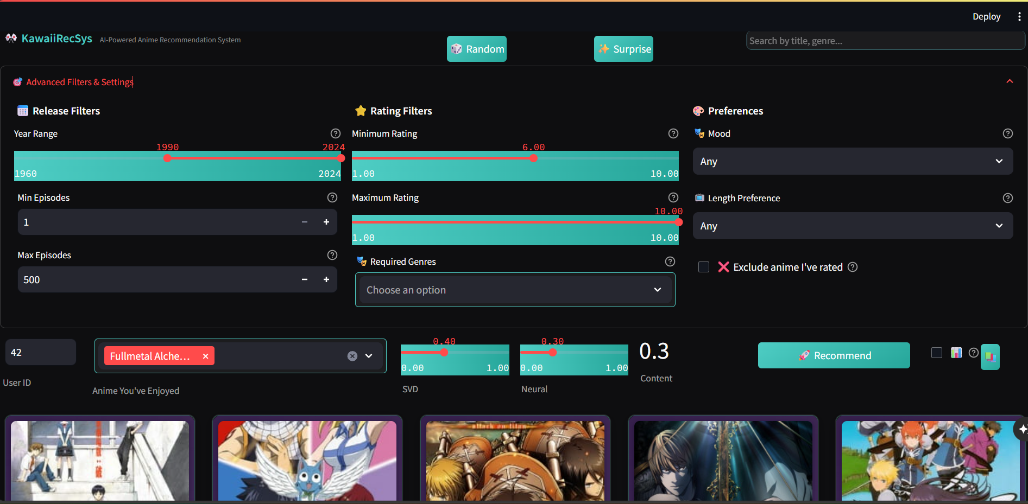

Slide 9
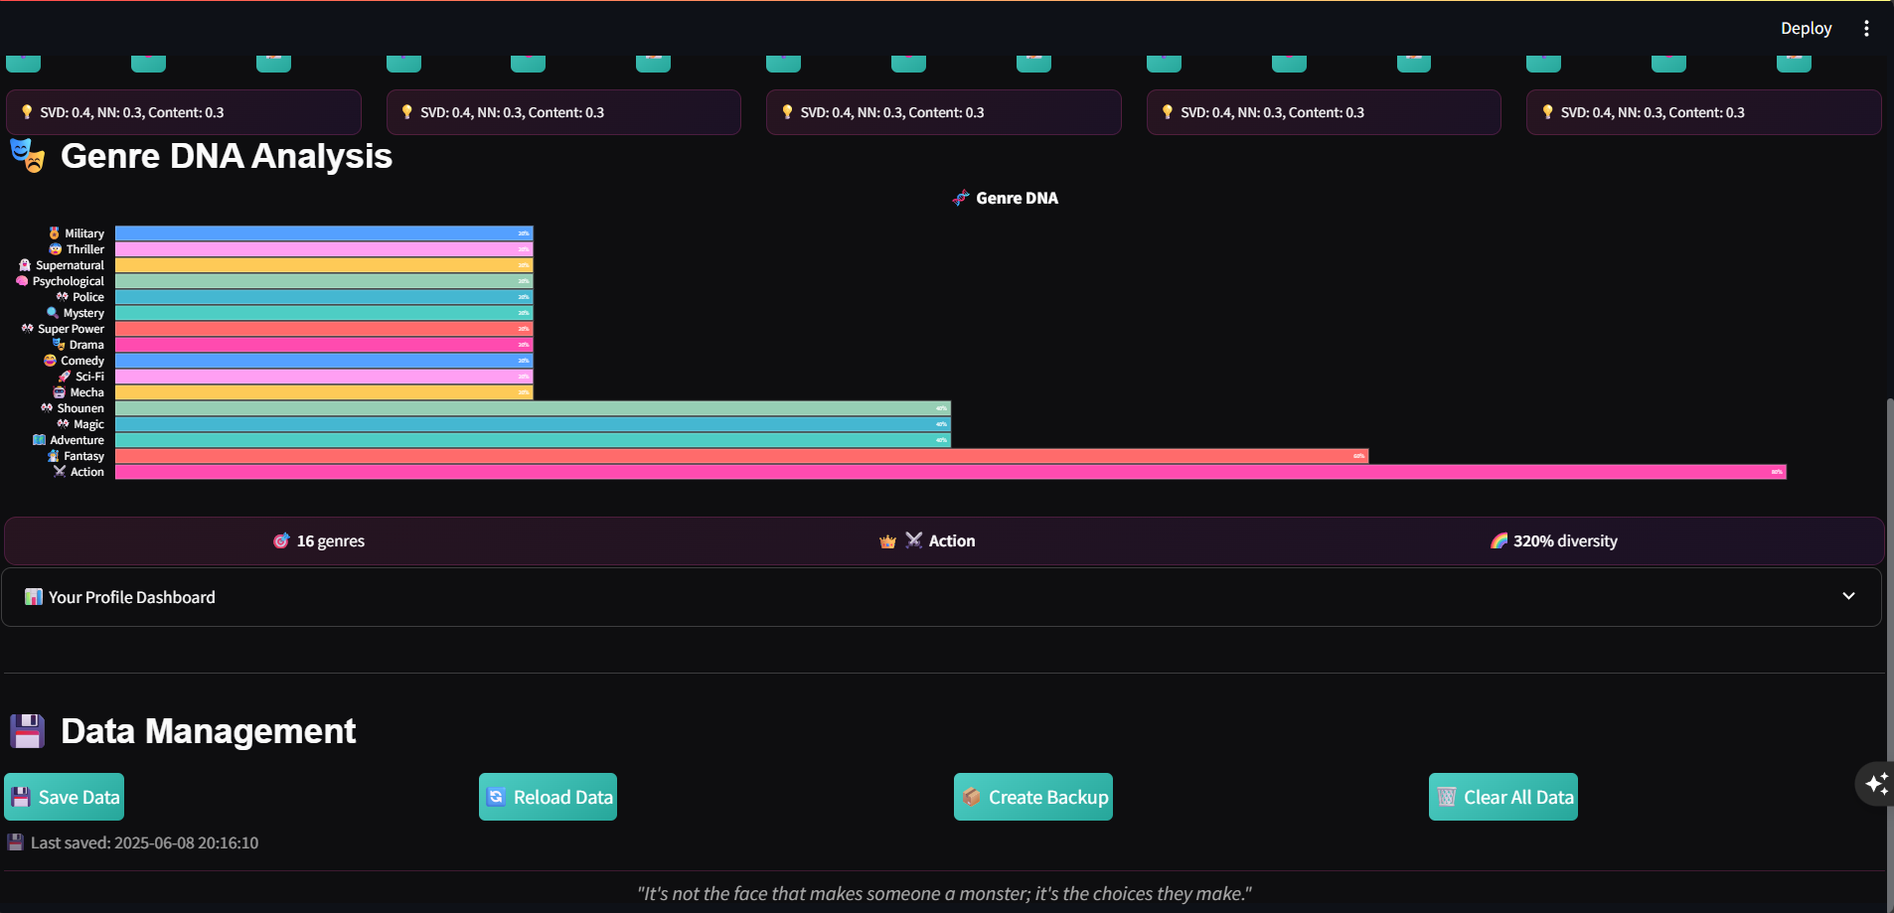

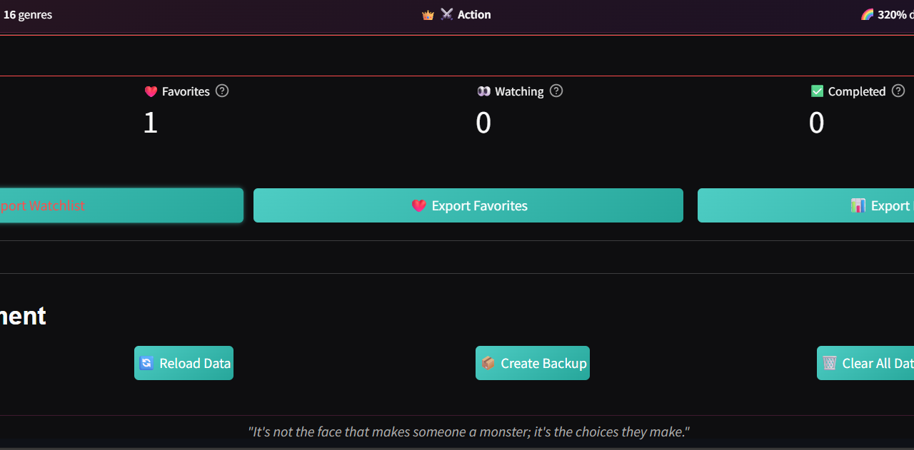

Slide 10


Future Enhancements
- Planned Upgrades:
- Add manga and movie recommendations
- Add community features (friend system, ratings)
- Use Transformer models for text-based personalization
- Voice or chat input for more interactive search

Slide 11

How KawaiiRecSys is Better Than Other Systems
Uses 3 models together: SVD, Neural Network, and Content-Based
Lets users control model weights with sliders
Has an easy and fun user interface
Shows recommendations as anime cards with images
Saves watchlist, favorites, and viewing status
Works well for both new and returning users
Includes genre-based visualization for better insight

Slide 12

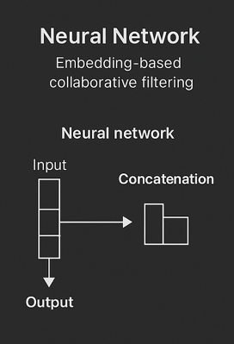
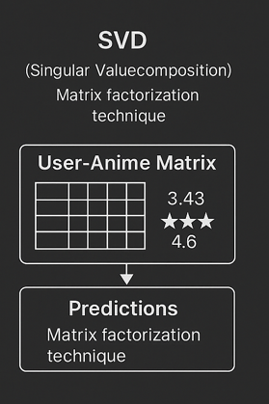
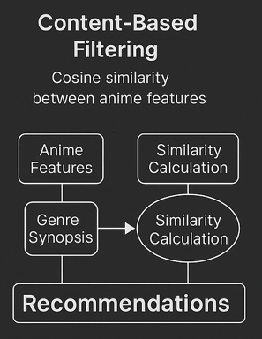

Slide 13


THANK YOU

